Slide 1
Spring Boot
Code with 0% Configuration
Gyenendra Yadav
Jindal InfoSolutions

Slide 2
Introduction – pivotal Say…
Spring Boot makes it easy to create stand-alone, production-grade Spring based Applications that you can “just run”. We take an opinionated view of the Spring platform and third-party libraries so you can get started with minimum fuss. Most Spring Boot applications need very little Spring configuration.
You can use Spring Boot to create Java applications that can be started using java -jar or more traditional war deployments. We also provide a command line tool that runs “spring scripts”.

Slide 3
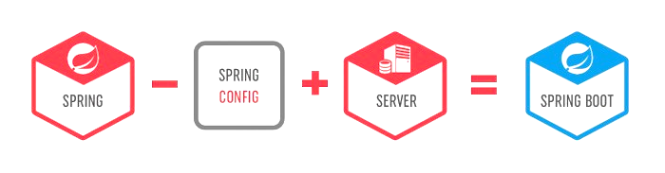

Slide 4
WHY We Need Spring Boot?
Spring Boot is next generation attempt to easy spring setup.
Spring Boot’s main benefit is configuring the resources based on what it finds in the classpath.
If your Maven POM includes JPA dependencies and a MYSQL driver, then Spring Boot will setup a persistence unit based on MySQL. If you’ve added a web dependency, then you will get Spring MVC configured with defaults.
When we talk about defaults, Spring Boot has its own opinions. If you are not specifying the details, it will use its own default configurations. If you want persistence, but don’t specify anything else in your POM file, then Spring Boot configures Hibernate as a JPA provider with an HSQLDB database.

Slide 5
primary goals
To provide a radically faster and widely accessible getting started development experience for all Spring development. Since spring community has evolved so big, it is time to re-invent the way how spring applications are deployed in much quicker turn around time.
To be get started so quickely using the default values which are supported out of the box in the Spring Boot configurations.
To provide bunch of non-functional features/solutions that are very much common to large scale projects (e.g. embedded servers, security, metrics, health checks, externalized configuration).

Slide 6
What Spring Boot brings to the table ?
Convention over configuration
Standardization for Microservices
Integrated Server for Development
Cloud Support
Adapt & Support for 3rd Party Library

Slide 7
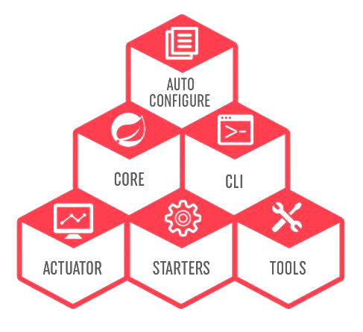
Spring Boot Components

Slide 8
Spring Boot Auto Configure
Module to auto configure a wide range of Spring projects.
It will detect availability of certain frameworks (Spring Batch, Spring Data JPA, Hibernate, JDBC).
When detected it will try to auto configure that framework with some sensible defaults, which in general can be overridden by configuration in an application.properties/yml(yaml-data serialization language) file.

Slide 9
Spring Boot Core
The base for other modules, but it also provides some functionality that can be used on its own, eg. using command line arguments and YAML files as Spring Environment property sources and automatically binding environment properties to Spring bean properties (with validation).

Slide 10
Spring Boot CLI
A command line interface, based on ruby, to start/stop spring boot created applications.

Slide 11
Spring Boot Actuator
This project, when added, will enable certain enterprise features (Security, Metrics, Default Error pages) to your application.
As the auto configure module it uses auto detection to detect certain frameworks/features of your application. For an example, you can see all the REST Services defined in a web application using Actuator.

Slide 12
Spring Boot Starters
Different quick start projects to include as a dependency in your maven or gradle build file.
It will have the needed dependencies for that type of application.
Currently there are many starter projects and many more are expected to be added.

Slide 13
Spring Boot Tools
The Maven and Gradle build tool as well as the custom Spring Boot Loader (used in the single executable jar/war) is included in this project.

Slide 14
How to use Spring Boot
You can use spring initialize to create the initial setup. You can visit either start.spring.io or use STS (Spring Tool Suite) Support available in IDEA or Eclipse to choose all the Spring Boot Starters
You need to also choose whether to use Maven or Gradle as the build tool.
If you are using start.spring.io, you need to then download the zip and configure your workspace. Otherwise using your preferred IDE will automatically create the required file in the workspace.
Add your code as required
You can either use mvn clean package or use IDEA or Eclipse to build and create the jar file.
By default the JAR would include integrated Tomcat server, so just by executing the JAR you should be able to use your program.

Slide 15
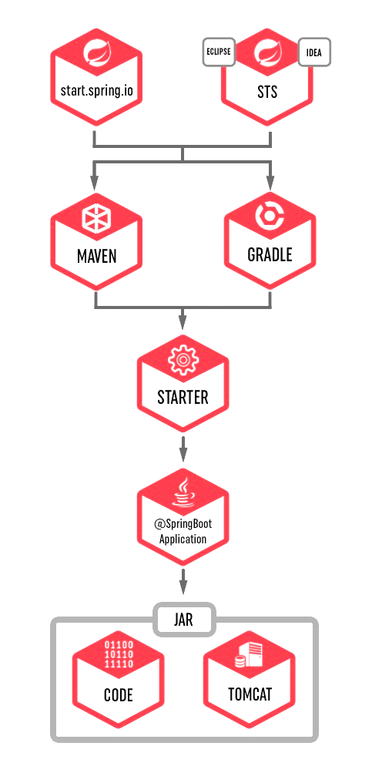

Slide 16
Environment Setup for Eclipse

Slide 17
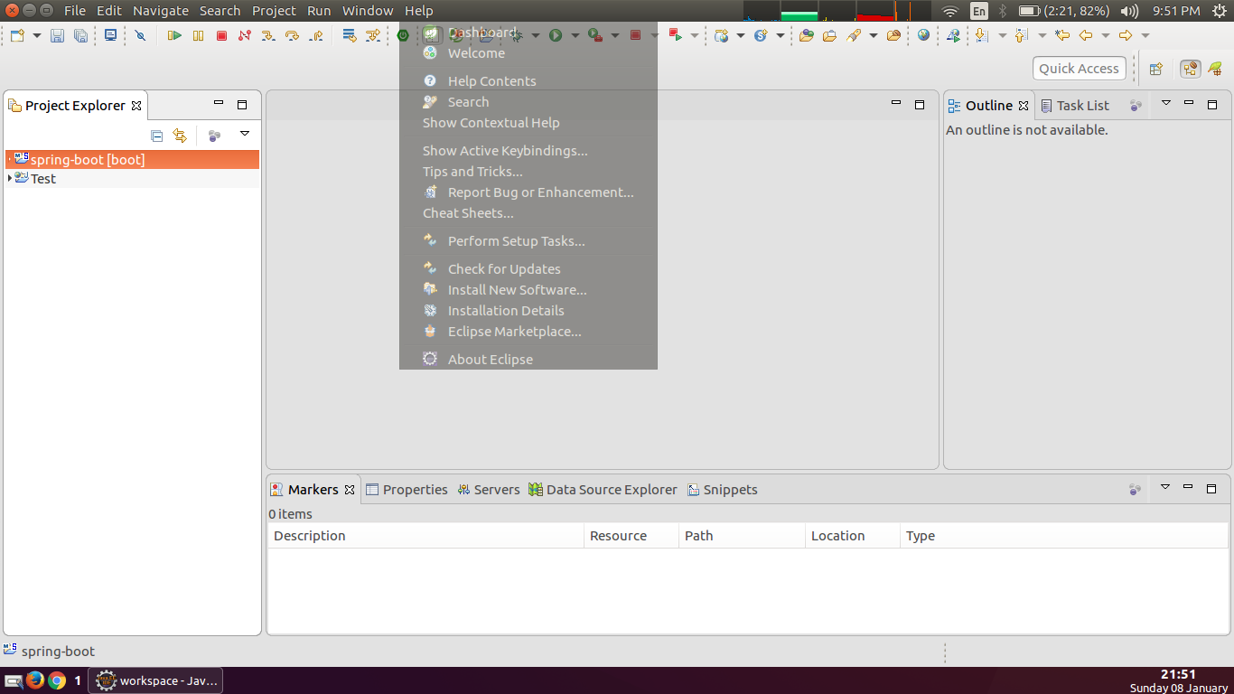

Slide 18
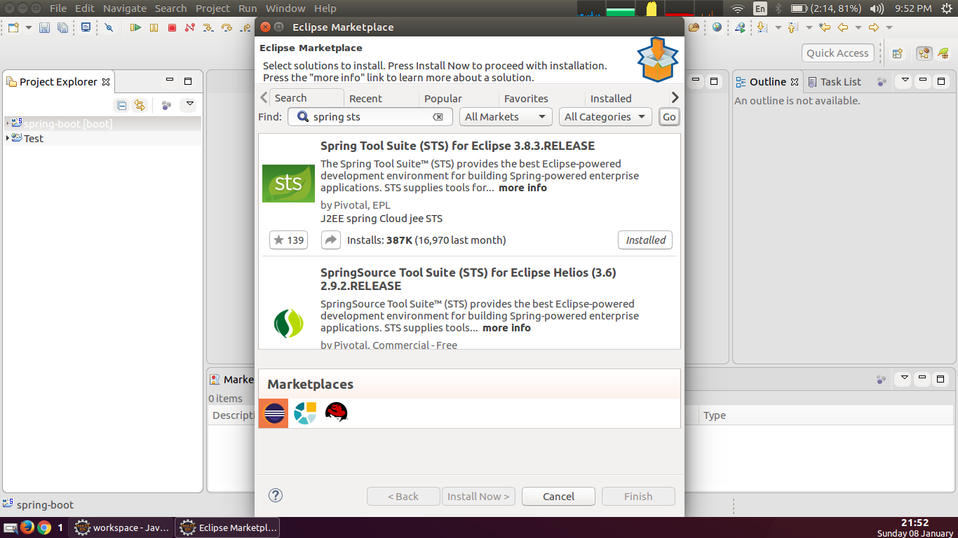

Slide 19
Create Project
Goto Window Menu -> Perspective ->Spring
Goto File Menu ->New -> Spring Starter Project

Slide 20
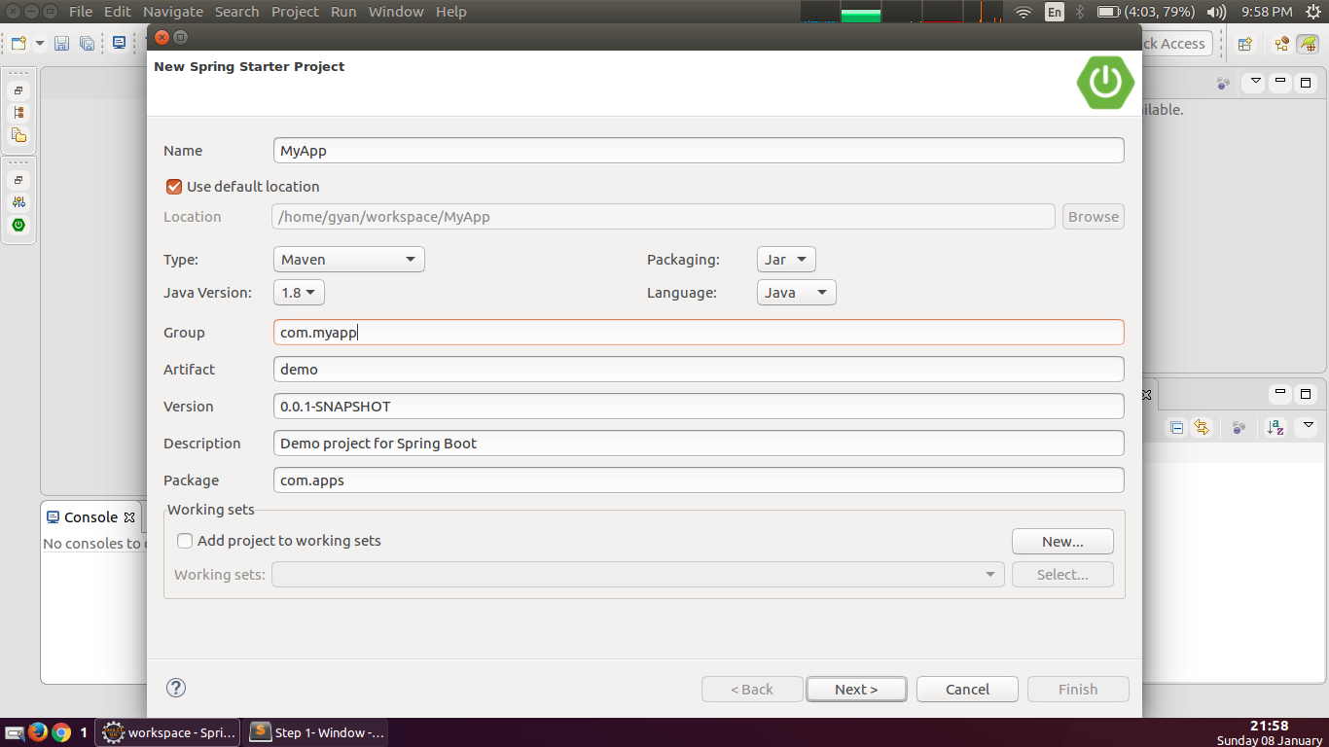

Slide 21
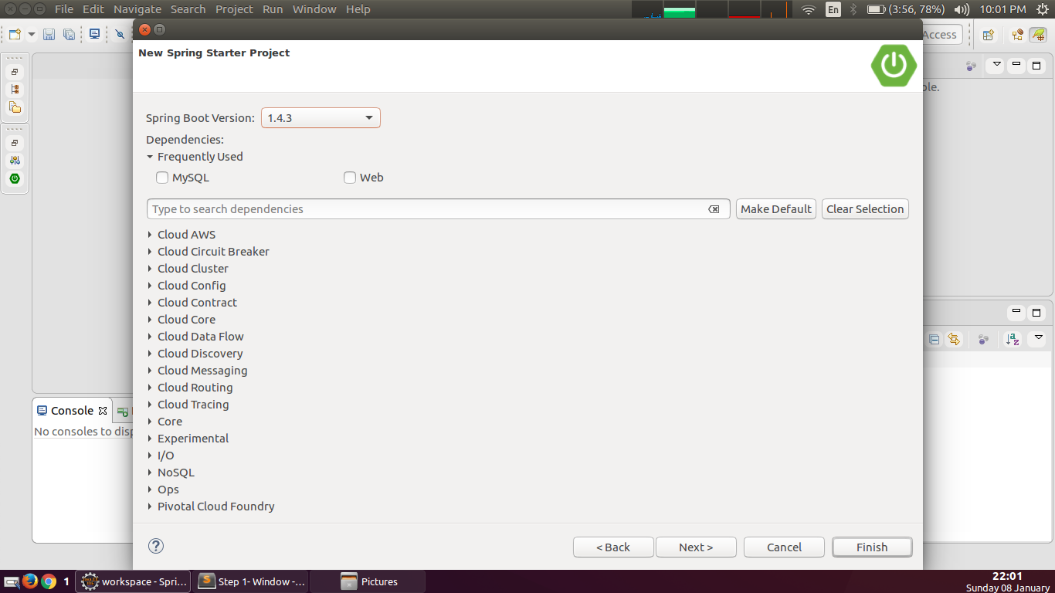

Slide 22
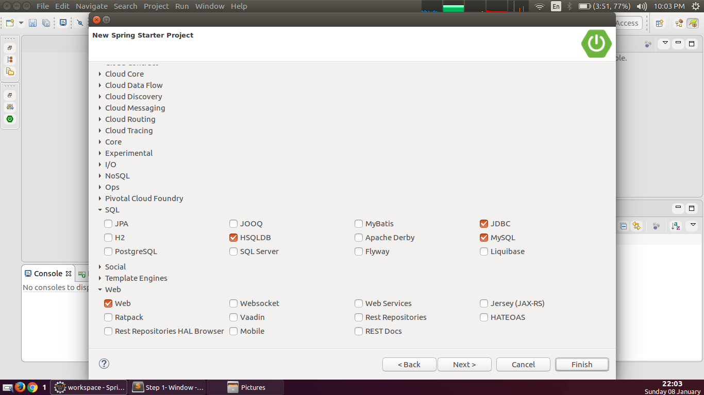

Slide 23
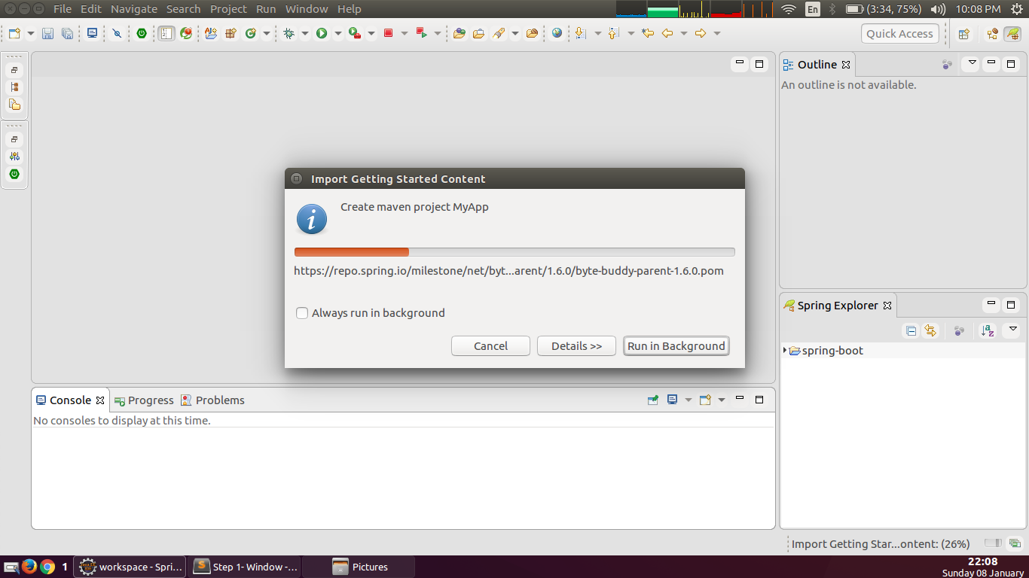

Slide 24
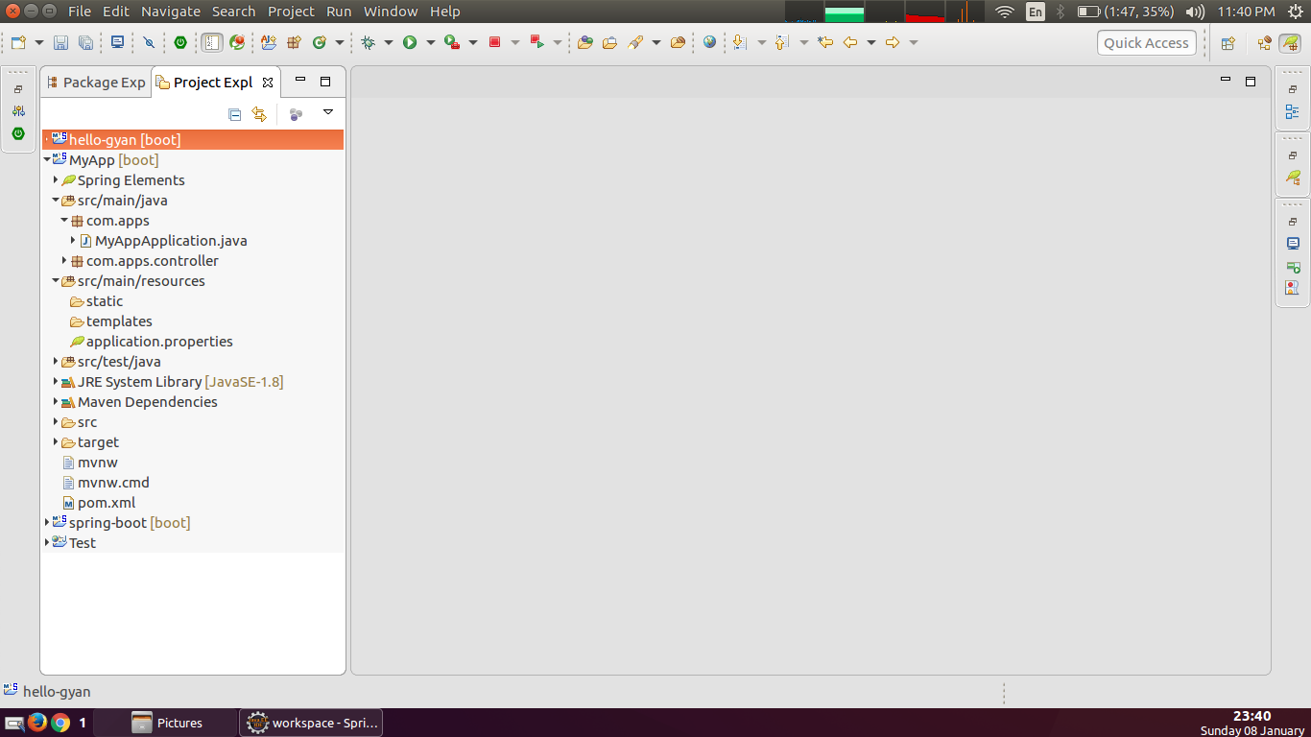

Slide 25
MyAppApplication Class
package com.apps;
import org.springframework.boot.SpringApplication;
import org.springframework.boot.autoconfigure.SpringBootApplication;
@SpringBootApplication
public class MyAppApplication {
public static void main(String[] args) {
SpringApplication.run(MyAppApplication.class, args);
}
}

Slide 26
@SpringBootApplication annotation
@SpringBootApplication annotation
Many Spring Boot developers always have their main class annotated with @Configuration, @EnableAutoConfiguration and @ComponentScan. Since these annotations are so frequently used together (especially if you follow the best practices above), Spring Boot provides a convenient @SpringBootApplication alternative.
The @SpringBootApplication annotation is equivalent to using @Configuration, @EnableAutoConfiguration and @ComponentScan with their default attributes:

Slide 27
SpringApplication.run()
You need to run Application.run() because this method starts whole Spring Framework. Code below integrates your main() with Spring Boot.
public class SpringApplication extends Object
Classes that can be used to bootstrap and launch a Spring application from a Java main method. By default class will perform the following steps to bootstrap your application:
Create an appropriate ApplicationContext instance (depending on your classpath)
Register a CommandLinePropertySource to expose command line arguments as Spring properties
Refresh the application context, loading all singleton beans
Trigger any CommandLineRunner beans
In most circumstances the static run(Object, String[]) method can be called directly from your main method to bootstrap your application:

Slide 28
application.properties File
spring.datasource.url=jdbc:mysql://localhost:3306/springboot
spring.datasource.username=admin
spring.datasource.password=admin
spring.datasource.driver-class-name=com.mysql.jdbc.Driver
# Allows Hibernate to generate SQL optimized for a particular DBMS
spring.jpa.properties.hibernate.dialect=org.hibernate.dialect.MySQL5Dialect
# Number of ms to wait before throwing an exception if no connection is available.
spring.datasource.tomcat.max-wait=10000
# Maximum no of active conn that can be allocated from this pool at the same time.
spring.datasource.tomcat.max-active=50
# Validate the connection before borrowing it from the pool.
spring.datasource.tomcat.test-on-borrow=true

Slide 29
Continue…….
# Keep the connection alive if idle for a long time (needed in production)
spring.datasource.dbcp.test-while-idle=true
spring.datasource.dbcp.validation-query=SELECT 1
# Naming strategy
spring.jpa.hibernate.naming.strategy=org.hibernate.cfg.ImprovedNamingStrategy
# Hibernate ddl auto (create, create-drop, update): with "update" the database
# schema will be automatically updated accordingly to java entities found in
# the project
spring.jpa.hibernate.ddl-auto=update
# Show or not log for each sql query
spring.jpa.show-sql = true

Slide 30
Load Custom Application Context
package com.apps;
import org.springframework.boot.SpringApplication;
import org.springframework.boot.autoconfigure.SpringBootApplication;
@SpringBootApplication
@ImportResource("applicationContext.xml")
public class MyAppApplication {
public static void main(String[] args) {
SpringApplication.run(MyAppApplication.class, args);
}
}

Slide 32
Thank you
References
http://docs.spring.io/spring-boot/docs/2.0.x-SNAPSHOT/reference/html/
http://www.adeveloperdiary.com/java/spring-boot/an-introduction-to-spring-boot/
Assignment For you
Configure yourself
How to create jar for deployment on production server

